Slide 1
Instant Messaging Web Application
1 Minute Pitch Presentation
20120048 김현승
20166434 Léo Schneider
20166488 Pierre ThéveneT

Slide 2
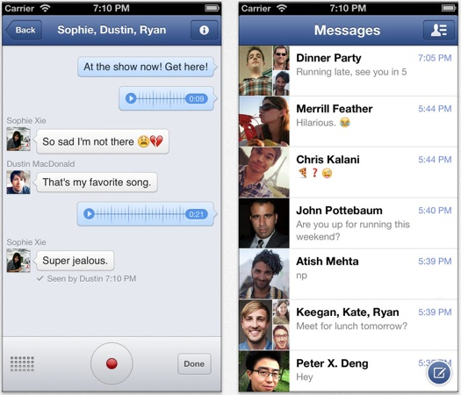
Instant Messaging
We are developing instant messaging application for web environment, allowing two or more people to discuss whether they are online or not

Slide 3
Design
We are designing two types of communication mechanism, server connection and direct connection without server
Server connection
Peer to peer connection
Server
User
User
User
User
User

Slide 4
Features
- Video-Audio chats between 2 or more people
- Possibility to create 'events‘.
- Message hierarchy.
- Easy sharing of locations
- Friends recommendation
- Mini-game playing
- Calendar
- Public chat rooms
-

Slide 5
Thank you

